Slide 1
CGB1201 – JAVA PROGRAMMING PROJECT REVIEW-2
Department of Artificial Intelligence and Data Science
Academic Year: 2024 – 2025 (Odd Semester)
Register Number :2303811724321117
Name :THILIPKUMAR S
Year : II
Semester : III
Section : B
Date :03/12/2024

Slide 2
TITLE OF THE PROJECT
Online Book Buying And Selling Portal

Slide 3
PROBLEM IDENTIFICATION
User Trust and Security: Risk of fake accounts, fraudulent listings, and lack of secure payment options.
Quality Control: Inconsistent or misleading book descriptions and poor-quality images.
Logistics Challenges: Delays, lost shipments, or high shipping costs due to unreliable third-party logistics.
Search Efficiency: Difficulty in finding books due to poorly implemented search and filter features.
Scalability Issues: Platform may slow down under high traffic without robust backend architecture.
Dispute Resolution: Frequent disagreements over book conditions or trades, leading to user dissatisfaction.

Slide 4
INTRODUCTION
The Online Book Buying and Selling Portal is a web-based system enabling users to buy, sell, and manage books seamlessly. This platform connects buyers and sellers, providing features like book listing, search, order management, payment integration, and user authentication. The system emphasizes efficiency, user-friendliness, and scalability while ensuring a secure transaction environment.

Slide 5
JAVA PROGRAMMING - CONCEPTS USED
Object-Oriented Programming (OOP)
Collections Framework
File Handling
Multithreading
Exception Handling

Slide 6
PROPOSED ARCHITECTURE
Book portal
Buyer
Browse
Buy
Trade
Seller
List books
Sell books
Manage

Slide 7
LIST OF MODULES
User Management
Book Management Search and Filter Order Processing Payment Gateway Integration
Admin Module

Slide 8
MODULE DESCRIPTION
1. User Management Allows buyers and sellers to create, update, and manage their profiles. Implements authentication and authorization.
2. Book Management Enables sellers to add new listings with book details like price, condition, and availability. Buyers can browse and view books.
3. Search and Filter Provides advanced filters for refined book searches.

Slide 9
MODULE DESCRIPTION
4. Order Processing: Handles cart management, checkout, and real-time order tracking.
5. Payment Gateway Integration: Integrates third-party payment services like PayPal or Stripe. Ensures secure and smooth payment processing.
6. Admin Modul: Monitors system activity and resolves disputes. Analyzes sales and user engagement metrics.

Slide 10
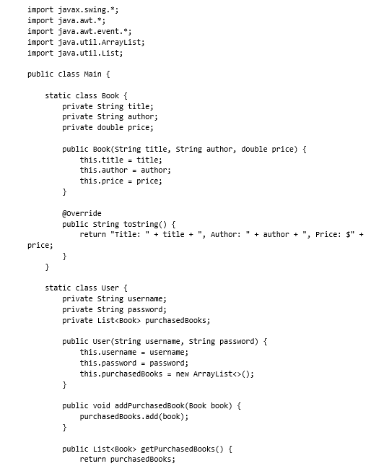
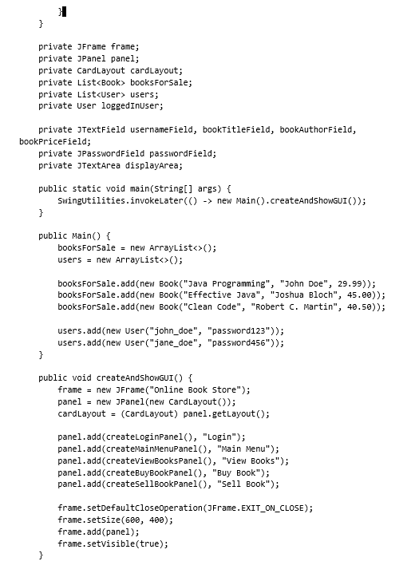
SOURCE CODE

Slide 11
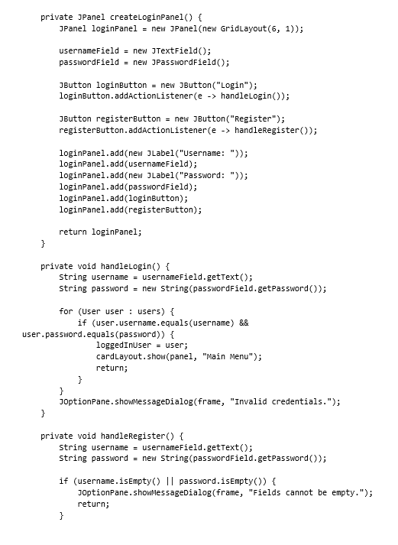
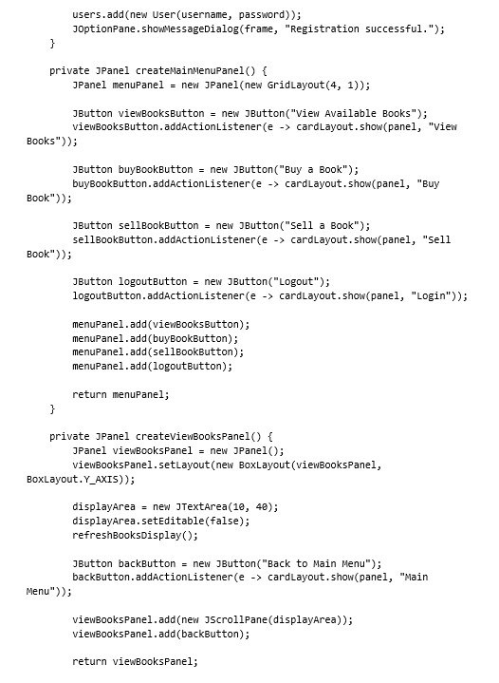
SOURCE CODE

Slide 12
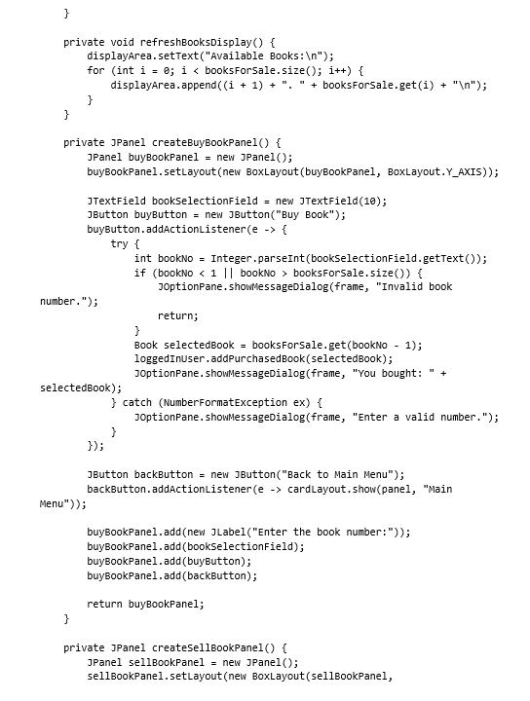
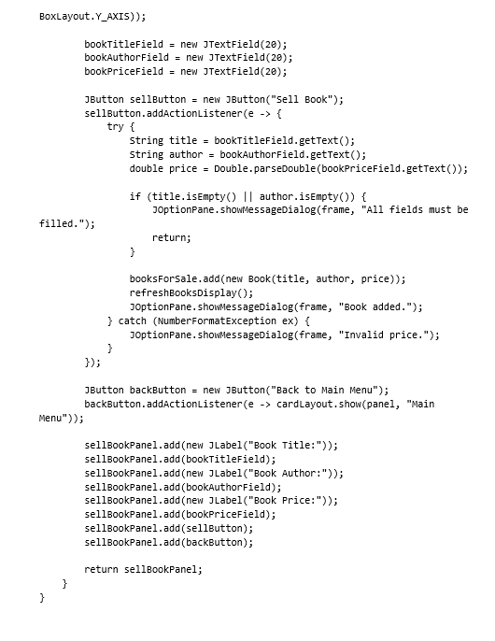
SOURCE CODE

Slide 13
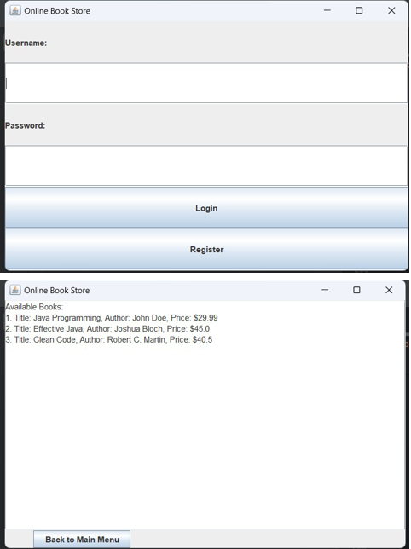
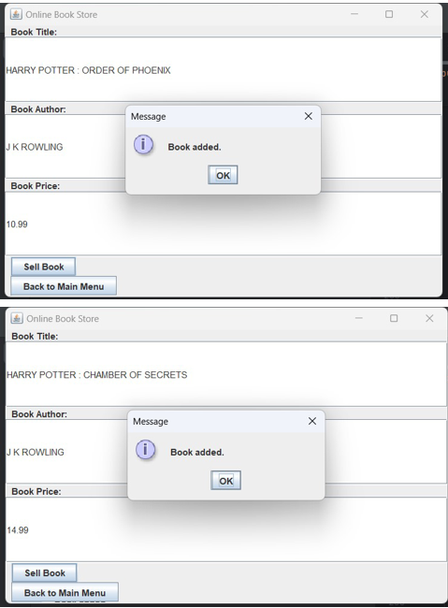
RESULTS AND DISCUSSION

Slide 14
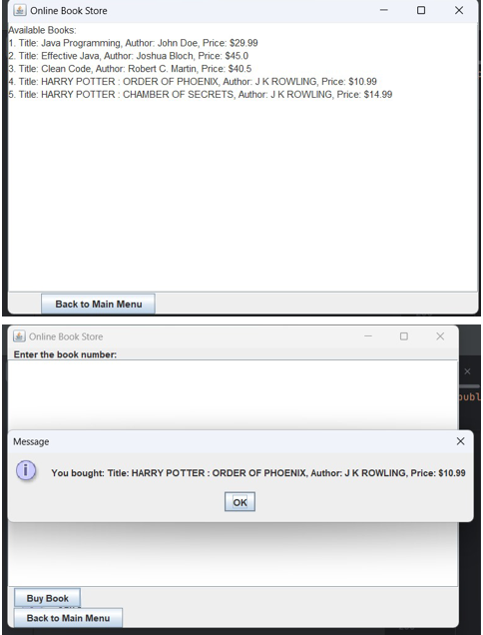
RESULTS AND DISCUSSION

Slide 15
CONCLUSION
The Online Book Buying and Selling Portal successfully bridges the gap between book buyers and sellers by offering a secure, scalable, and user-friendly platform. It is a step forward in digitizing book transactions while enhancing user satisfaction through modern technology.

Slide 16
THANK YOU

